Slide 1
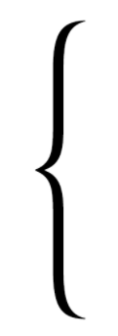
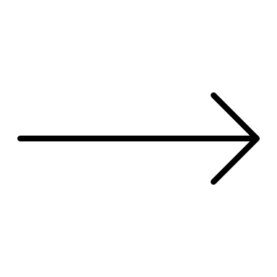

Backdrop
2m
Ball (4, 5, 6 m/s left or right)
Speed*Occlusion Duration (0.5, 0.6, 0.7s)
Target
Rectangle
invisible
10m
Observer (static or 3.6 m/s left/right)

Slide 2
2m
Target (4, 5, 6 m/s left or right)
10m
Observer (static or 3.6 m/s left or right)

